Slide 1
Survey Research Methods
Refs: H. Müller , A. Sedley , and E. Ferrall-Nunge

Slide 2
Overview
A survey is a method of gathering information by asking questions to a subset of
people, the results of which can be generalized to the wider target population. There
are many different types of surveys, many ways to sample a population, and many
ways to collect data from that population.

Slide 3
Overview
A survey is a method of gathering information by asking questions to a subset of
people, the results of which can be generalized to the wider target population. There
are many different types of surveys, many ways to sample a population, and many
ways to collect data from that population.
Traditionally, surveys have been administered via mail, telephone, or in person. The
Internet has become a popular mode for surveys due to the low cost of gathering data,
ease and speed of survey administration, and its broadening reach across a variety of
populations worldwide.

Slide 4
Overview
In human–computer interaction (HCI) research can be useful to:

Slide 5
Overview

Slide 6
Overview

Slide 7
User Attitudes
Intent
Task Success
User Experience Feedback
User Characteristics
Interactions with Technology
User Awareness

Slide 8
Precise Behaviors
Underlying Motivations
Usability Evaluations!!

Slide 12
Probability Versus Non-probability Sampling
Sampling a population can be accomplished through probability- and non-probability-based
methods. Probability or random sampling is considered the gold standard because every
person in the sampling frame has an equal, nonzero chance of being chosen for the sample;
essentially, the sample is selected completely randomly.
This minimizes sampling bias, also known as selection bias, by randomly drawing the
sample from individuals in the sampling frame and by inviting every- one in the sample
in the same way.

Slide 13
Convenience Sampling
While probability sampling is ideal, it is often impossible to reach and randomly select from
the entire target population, especially when targeting small populations (e.g., users of a
specialized enterprise product or experts in a particular field) or investigating sensitive or
rare behavior. In these situations, researchers may use non-probability sampling methods
such as volunteer opt-in panels, unrestricted self-selected surveys (e.g., links on blogs and s
ocial networks), snowball recruiting (i.e., asking for friends of friends), and convenience
samples (i.e., targeting people readily available, such as mall shoppers).

Slide 14
Sample Size and Error Margin
First, the researcher needs to determine approximately how many people make up the
population being studied. Second, as the survey does not measure the entire population,
the required level of precision must be chosen, which consists of the margin of error and
the confidence level.
The margin of error expresses the amount of sampling error in the survey, i.e., the range
of uncertainty around an estimate of a population measure, assuming normally distributed
data. For example, if 60 % of the sample claims to use a tablet computer, a 5 % margin of
error would mean that actually 55–65 % of the
population use tablet computers.

Slide 15
Sample Size and Confidence Interval
The confidence level indicates how likely the reported metric falls within the margin of error
if the study were repeated. A 95 % confidence level, for example, would mean that 95 % of
the time, observations from repeated sampling will fall within the interval defined by the
margin of error. Commonly used confidence levels are 99, 95, and 90 %.
Figure 4, based on Krejcie and Morgan’s formula (1970), shows the appropriate sample
size, given the population size, as well as the chosen margin of error and confidence level
for your survey. Note that the table is based on a population proportion of 50% for the
response of interest, the most cautious estimation.
for a population larger than 100,000, a sample
size of 384 is required to achieve a confidence
level of 95 % and a margin of error of 5 %.

Slide 16
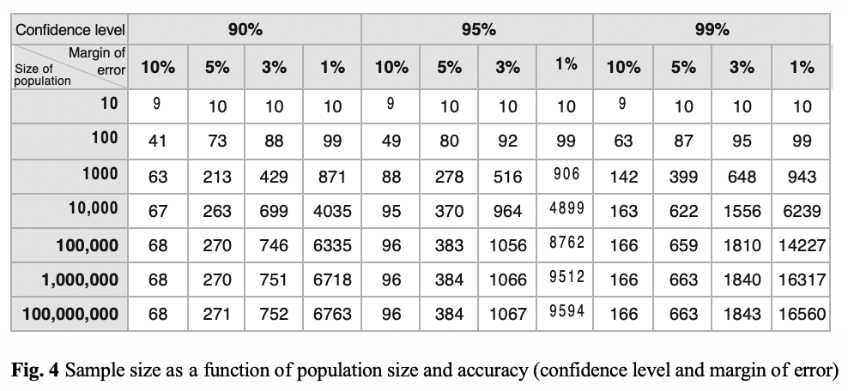
Sample Size, Error Margin and Confidence Interval

Slide 17
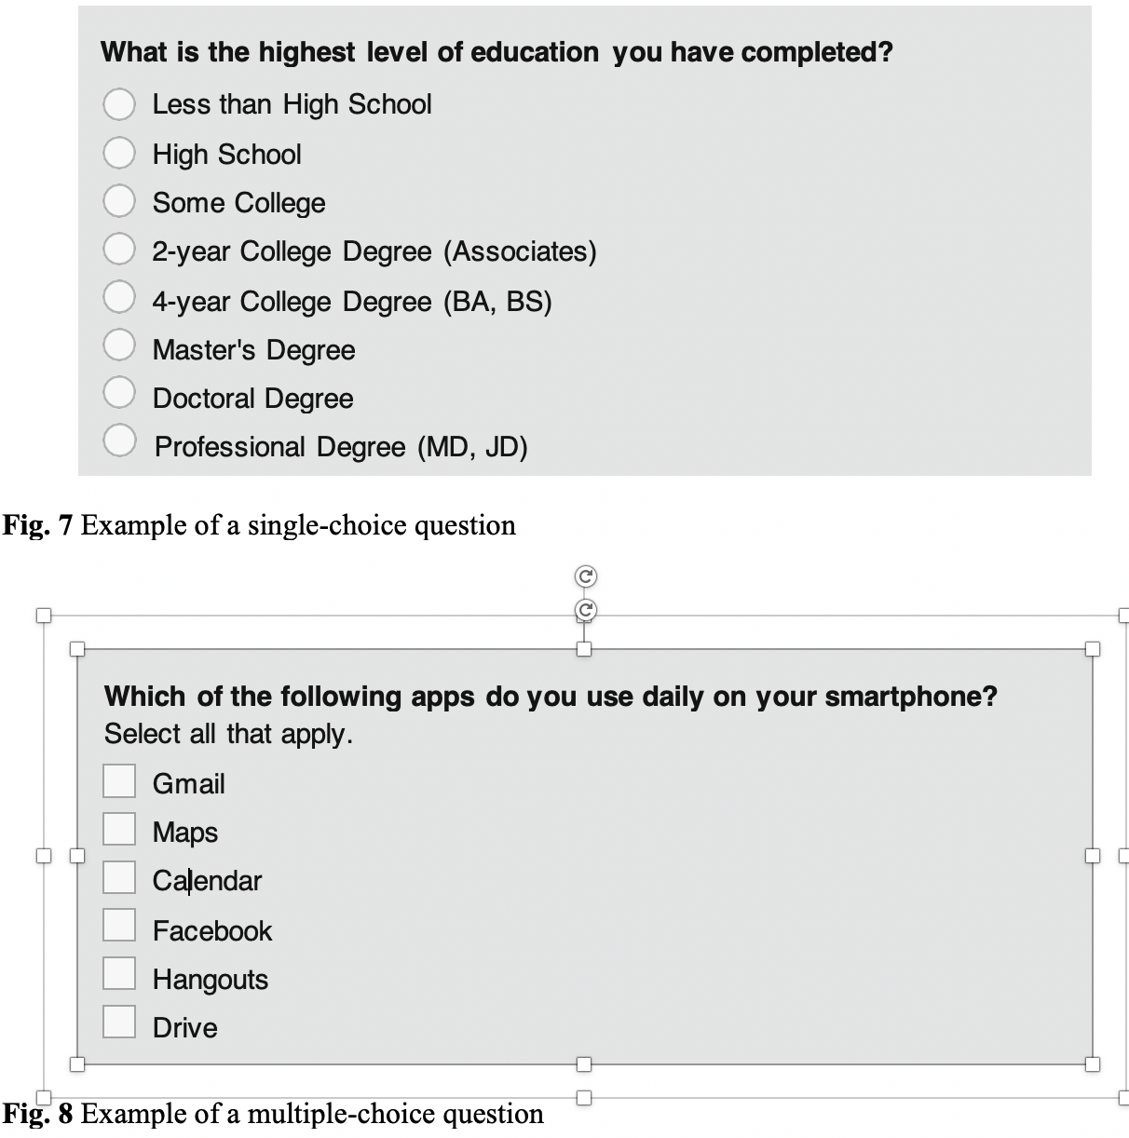
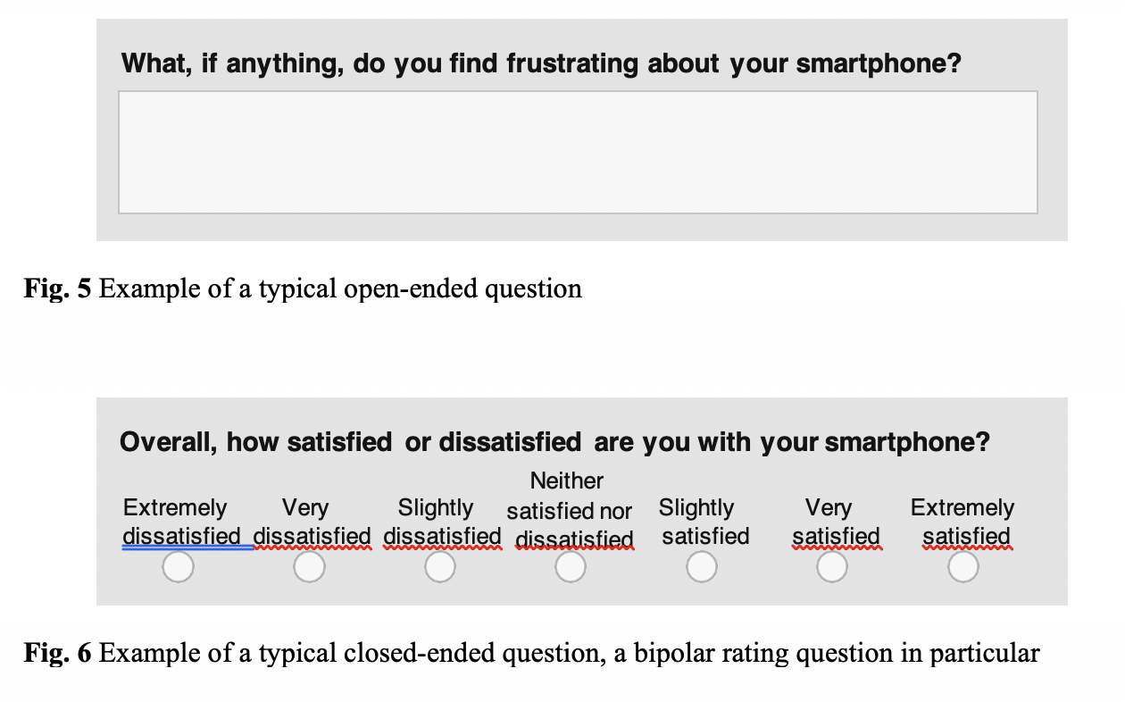
Questionnaire Design and Biases
Chapter gives many rules of thumb for various closed-end question survey design

Slide 18
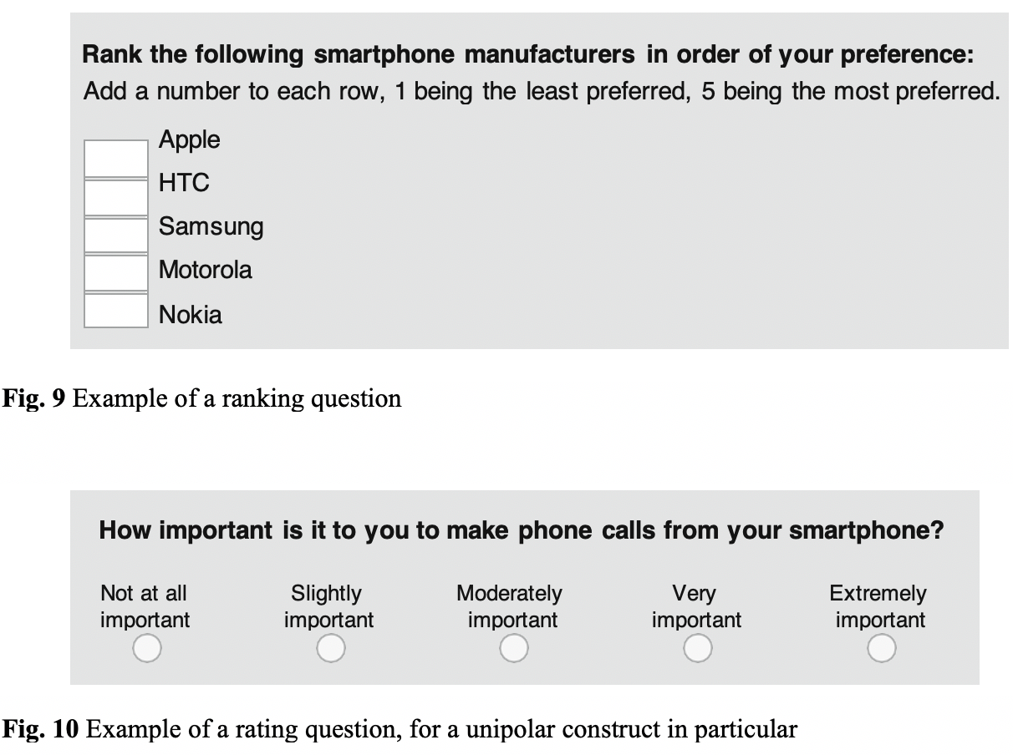
Questionnaire Design and Biases
Rating questions are appropriate when the
respondent must order their preferences.
Rankings questions are appropriate when
the respondent must put an object on a
continuum.

Slide 19
Questionnaire Biases
Five common questionnaire biases:
satisficing,
acquiescence bias,
social desirability,
response order bias, and
question order bias.

Slide 20
Satisficing Biases
Satisficing occurs when respondents use a suboptimal amount of cognitive effort to answer
questions. Instead, satisficers will typically pick what they consider to be the first acceptable
response alternative. Satisficing compromises 1 or 4 cognitive steps:
1. Comprehension of the question, instructions, and answer options
2. Retrieval of specific memories to aid with answering the question
3. Judgement of the retrieved information and its applicability to the question
4. Mapping of judgement onto the answer options
Satisficers shortcut this process by exerting less cognitive effort or by skipping one or
more steps entirely.
To minimize satisficing ….

Slide 21
Satisficing Biases
Simple instead of complex questions
Avoid “don’t know” and “unsure” etc etc.
Avoid using same rating scale in back to back questions
Keep questionnaires short
Increase motivation by stressing participant-centered importance/gain
Ask for justification
Use of trap questions

Slide 22
Acquiescence Biases
When presented with agree/disagree, yes/no, or true/false statements, some respondents
are more likely to concur with the statement independent of its substance or source.
Origins in both cognitive and personality variables. To minimize:
Avoid questions with agree/disagree, yes/no, true/false, or similar answer options
Where possible, ask construct-specific questions (i.e., questions that ask about the
underlying construct in a neutral, non-leading way) instead of agreement statements
Use reverse-keyed constructs; i.e., the same construct is asked positively and
negatively in the same survey. The raw scores of both responses are then combined
to correct for acquiescence bias.

Slide 23
Social Desirability Biases
Social desirability occurs when respondents answer questions in a manner they feel will
be positively perceived by others.
Respondents are inclined to provide socially desirable answers when:
- Their behavior or views go against the social norm
- Asked to provide information on sensitive topics, making the respondent
feel uncomfortable or embarrassed
- They perceive a threat of disclosure or consequences to answering truthfully
- Their true identity (e.g., name, address, phone number) is captured in the survey
- The data is directly collected by another person (e.g., in-person or phone surveys).
To minimize social desirability bias, respondents should be allowed to answer anonymously
or the survey should be self-administered.

Slide 24
Response Order Biases
Response order bias is the tendency to select the items toward the beginning (i.e., a
primacy effect) or the end (i.e., a recency effect) of an answer list or scale.
To minimize response order effects, the following may be considered:
Unrelated answer options should be randomly ordered across respondents
Rating scales should be ordered from negative to positive, with the most negative item first
The order of ordinal scales should be reversed randomly between respondents, and the
raw scores of both scale versions should be averaged using the same value for each scale
label. That way, the response order effects cancel each other out across respondents

Slide 25
Open-Ended Questions
Avoid overly broad questions (broader than actually experienced)
Avoid leading questions (don’t suggest a right answer)
Avoid querying about multiple objects/options in a preference or ranking
Avoid relying on highly accurate memory recall
Avoid prediction questions (don’t ask to anticipate future behavior
or future attitudes

Slide 26
Open-Ended Questions
Avoid overly broad questions (broader than actually experienced)
Avoid leading questions (don’t suggest a right answer)
Avoid querying about multiple objects/options in a preference or ranking
Avoid relying on highly accurate memory recall
Avoid prediction questions (don’t ask to anticipate future behavior
or future attitudes

Slide 27
Implementation
There are many platforms and tools that can be used to implement Internet surveys, such
ConfirmIt, Google Forms, Kinesis, LimeSurvey, SurveyGizmo, SurveyMonkey, UserZoom,
Wufoo, and Zoomerang, to name just a few.
When deciding on the appropriate platform, functionality, cost, and ease of use should be
taken into consideration. The questionnaire may require a survey tool that supports
functionality such as branching and conditionals, the ability to pass URL parameters,
multiple languages, and a range of question types.
Chapter discusses techniques for maximizing response rates, etc.

